Slide 1

Saver ‘n Savior

Slide 2
Features
Saver 'n Savior is a hybrid application which can manage everyday to-do lists with time and location based reminders.
By using this app, a user can register, login and then create a reminder. While creating the reminder, the user has an option to schedule a Call or a SMS to remind him/her of the task at the scheduled time. Here we used cloud based communication API, Twilio to make a call or send an SMS.
There is also an option of creating geofences, using cordova geofence plugin, so that when the user reaches a geofence area, then they will be reminded of the items in their to-do list.

Slide 3
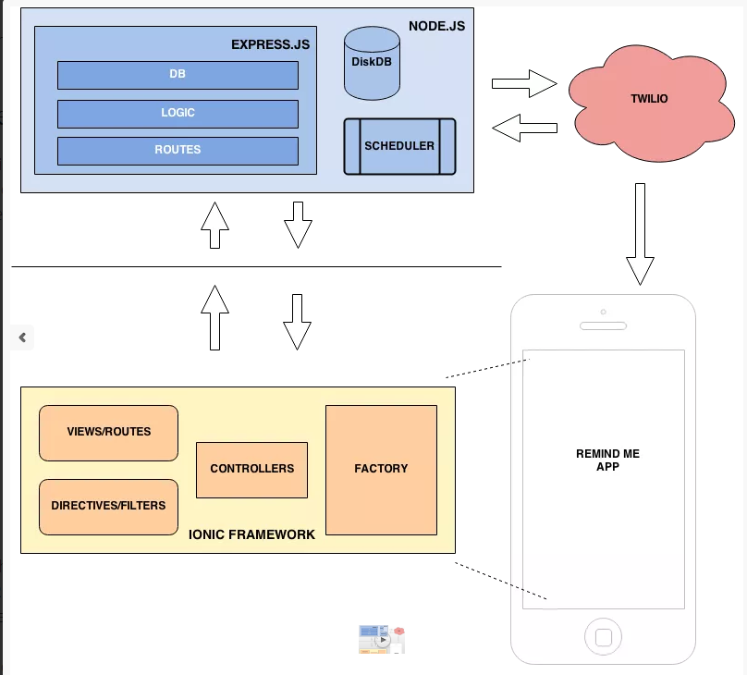
Architecture

Slide 4
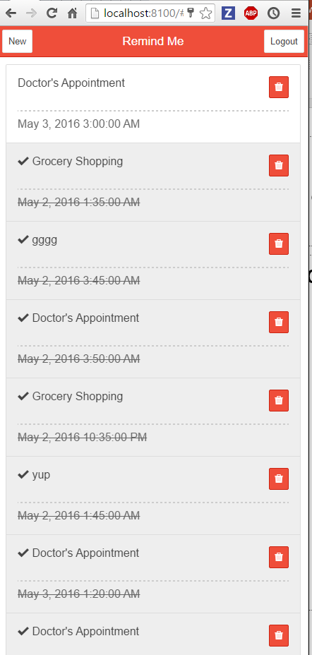
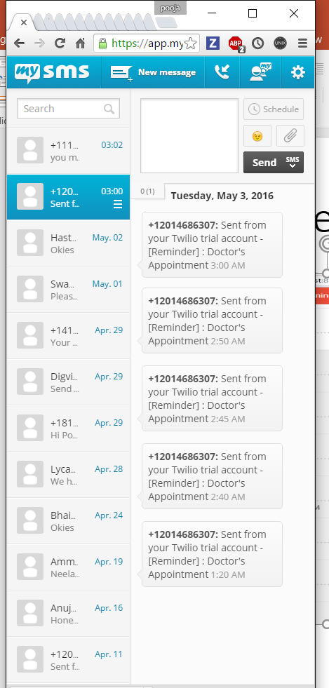
Reminder using Twilio

Slide 5
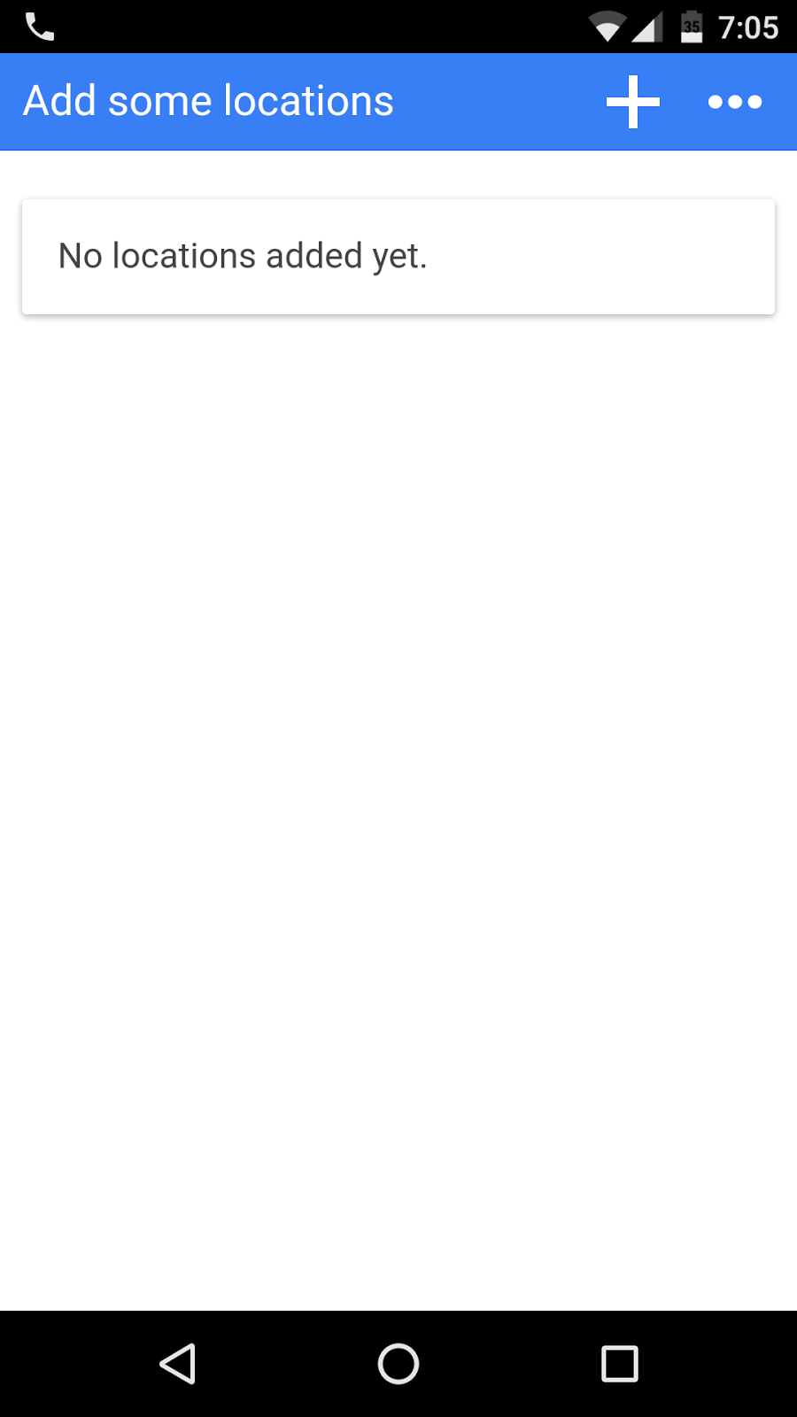
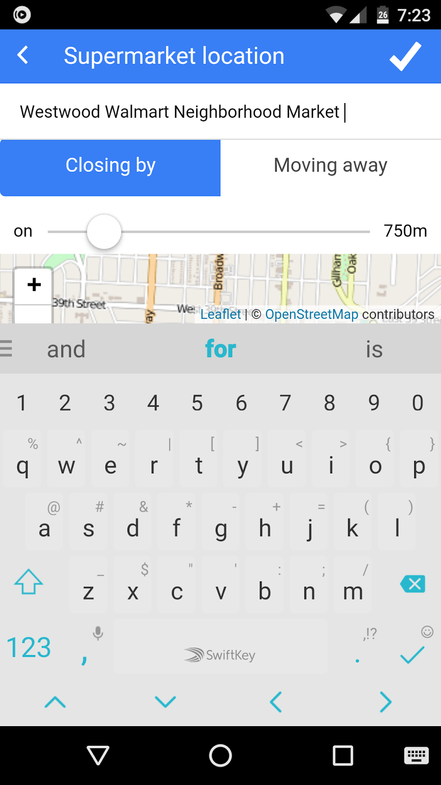
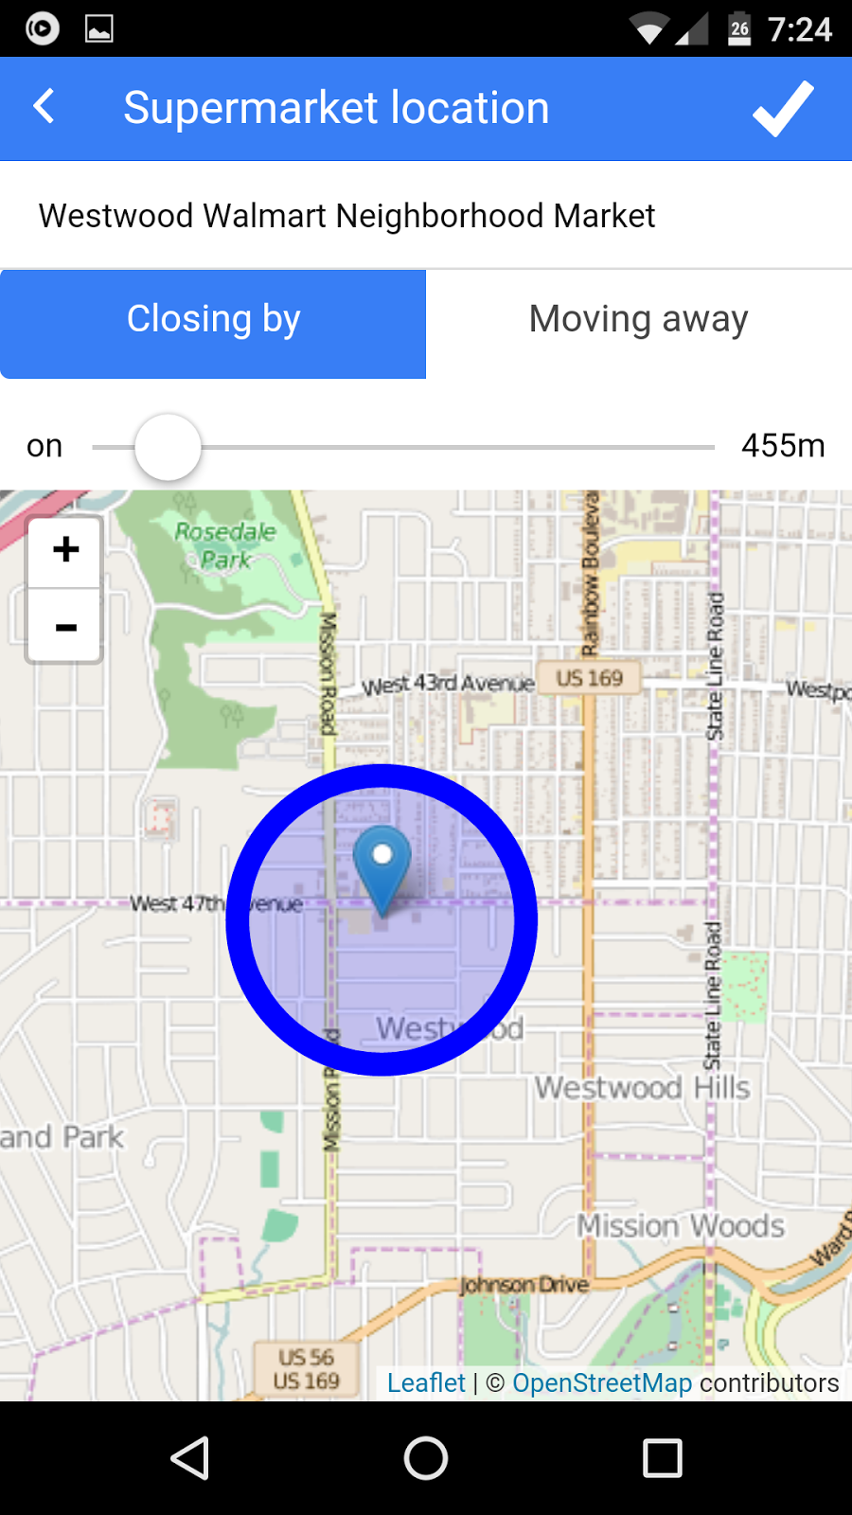
Push Notification using Geofence

Slide 6
